Slide 1

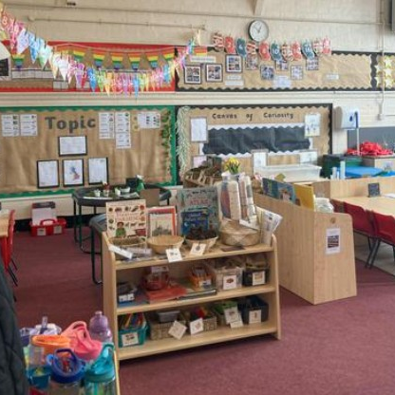
Meet the Teacher!
Miss Smedley
Year 1- Willow class

Slide 2
Welcome!
I teach full time in year 1- Monday to Friday.
My PPA afternoon is on a Wednesday- the children will be taught P.E by Mrs Goddard or Mrs Callahan- deputy headteacher/year 2 teacher.
If you need to speak during this time, then please message on dojo.

Slide 3
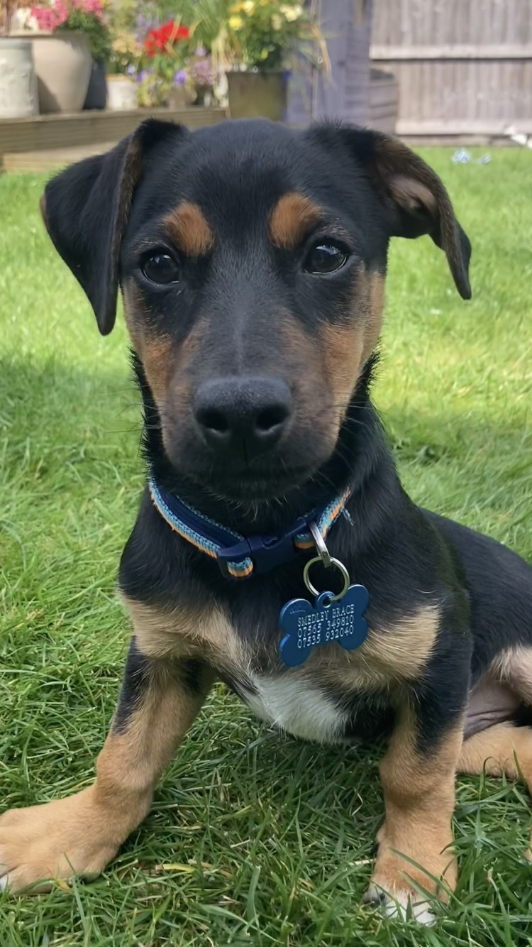


A bit about me
Mansfield was my local town growing up and I went to college at ‘West Notts’.
My family are local to the area.
I have a dog at home- called Dougie.
I have always taught within Key Stage One- at several different schools, with lots of different children.

Slide 4
A Day in Year One
8.40-9.15 | 9.20-10/ 10-10.30 | 10.30-10.45 | 10.45-11.45 | 11.45-1
Register and Phonics | English Continuous provision Handwriting and reading groups | BREAK | Maths Continuous provision | LUNCH
Morning
1-1.10 | 1.10-2.15 | 2.15-2.30 | 2.30-2.45 | 2.45-3 | 3-3.15
Register and yoga/meditation | Topic (History, Science, Geography) And Continuous provision | BREAK | Topic | Assembly | Story and home time
Afternoon

Slide 5
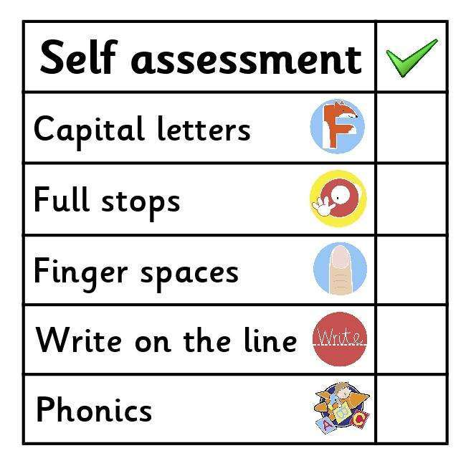

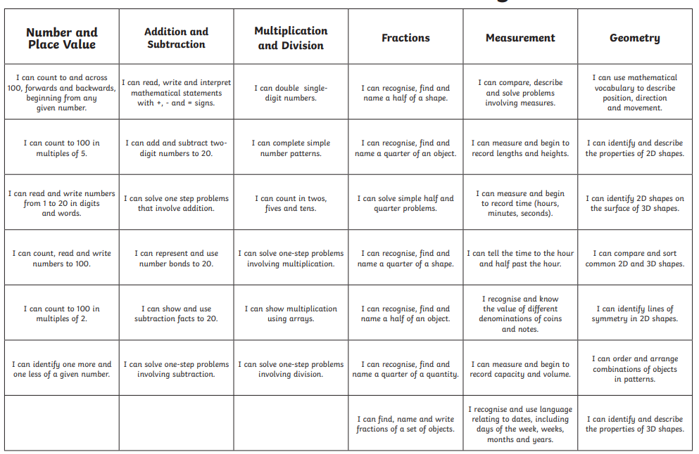
Curriculum coverage
English- basic sentence structure, capital letters, full stops, simple conjunctions (and because but).
Maths- numbers to 100, addition, subtraction, multiple groups, sharing. Measuring, fact families (7+3=10 10-3=7).
Science- human body, animal groups, materials and plants.

Slide 6


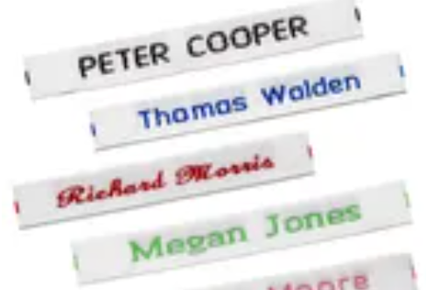
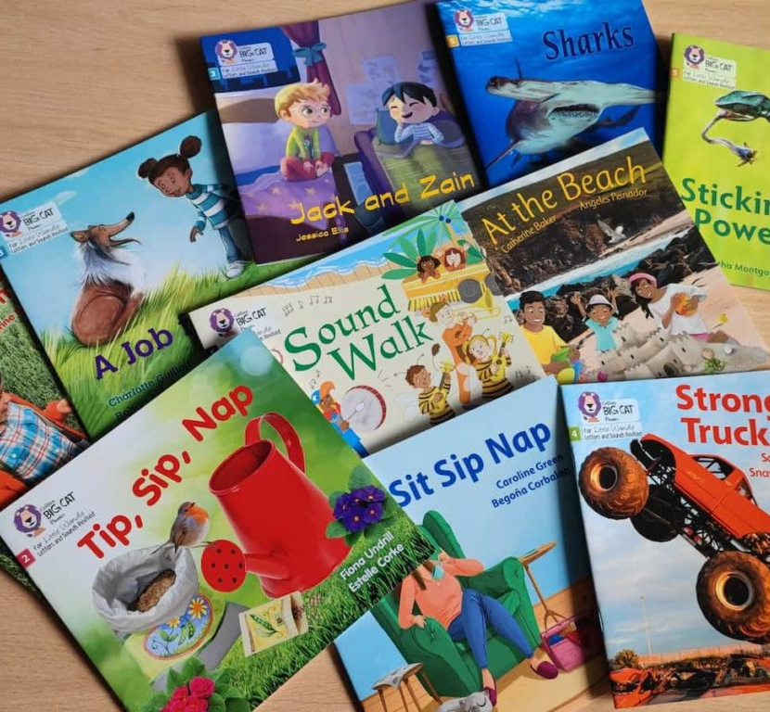
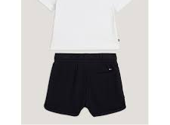
More information
P.E- Wednesday afternoons
No earrings/jewelry, long hair tied up, white top and black shorts/joggers/leggings and trainers.
Please bring wellies in for OPAL play- and sensible coat (waterproof).
No toys in school, please keep these at home unless previously agreed.
Named uniform- please write your child’s name in their jumpers/cardigans/coats.
Homework- Maths based, Thursday’s it will be sent home in your child’s bag.
Reading books- Little Wandle- Wednesday- Wednesday swapped weekly (unless not possible) missing books do require a payment.

