Slide 1

Year 4 Welcome Meeting
2025-2026

Slide 2
Year 4 Staff
Miss Ward- Palm
Mrs Siddal and Mr Vere- Kapok
Mrs Goddard (AM)
Mr Jenkins (AM)
Mr Starr

Slide 3

Communication
Dojo is our main communication tool although we understand sometimes a face-to-face conversation is needed
Although we try to check regularly, dojo cannot always be checked within the school day so if it is urgent please call the office
The class story and website will be updated regularly
Parents evenings will be held twice throughout the year, and we encourage face-to-face meetings for this

Slide 4
Year 4 Expectations
Arrive on time, school starts at 8.40 prompt
School uniform
PE kit/swimming kit
Presentation
Independence
Homework, reading and timestables

Slide 5

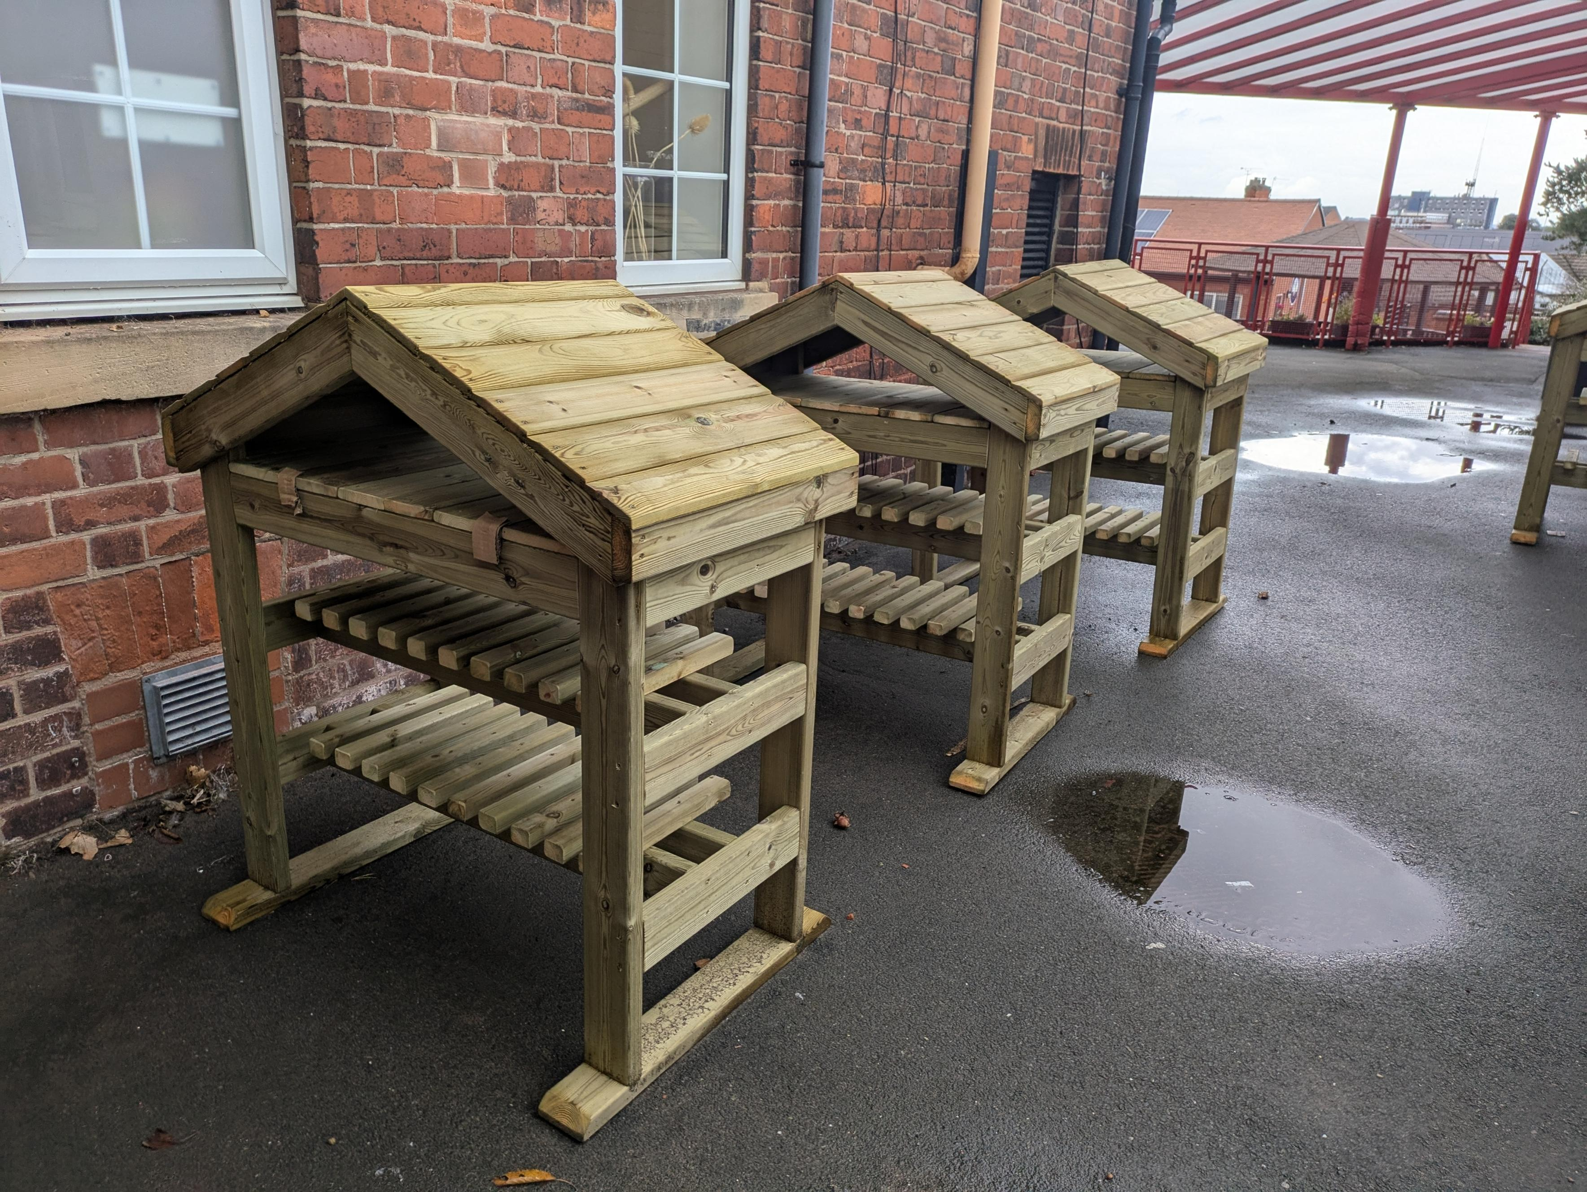
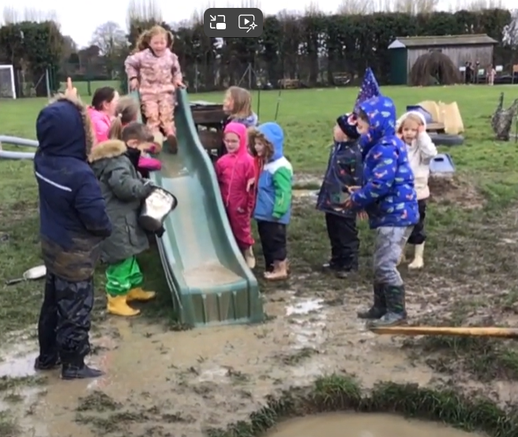
Play is 20% of a child’s school life.
Now that the weather is cold and wet children need appropriate clothing for this.
Waterproofs and wellies.

Slide 6
PE and Swimming
Autumn PE- Tuesday and Wednesday
Spring and Summer– Swimming
Palm- Monday
Kapok- Thursday
Can you help?

Slide 7
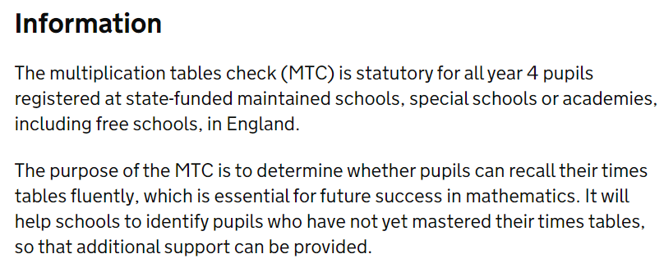
Multiplication Check
Gov.Uk states:
The test will take place in June 2025
The children complete it in class in small groups with a familiar adult
The test is out of 25 and is a simple pass or fail
It does not directly impact their maths assessment

Slide 8
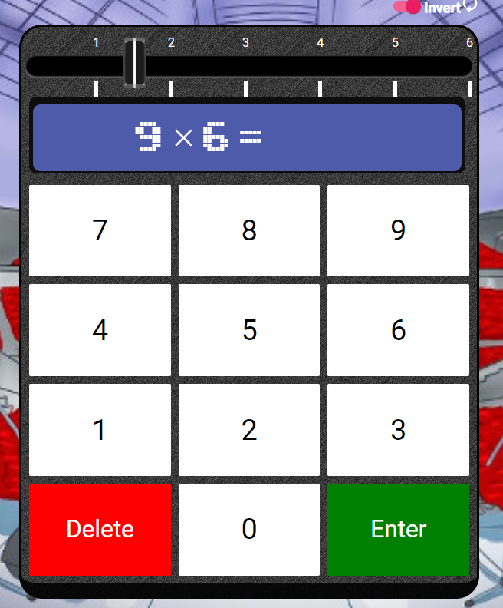
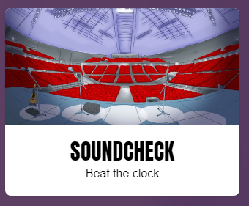
TTRS
TTRS log ins will be glued into diaries
We will start on garage to build knowledge and confidence
Soundcheck mimics the government check format
Children must practice at home, this is set as our homework

Slide 9
Homework
Homework will follow the school policy and remain the same as last year.
Maths, SPAG or Reading – Thursday to Thursday
TTRS – Thursday to Thursday
Creative homework – Termly (optional)

Slide 10
Year 4 Topics
Ancient Greeks - Autumn
Amazon Rainforest - Spring
Roman Invasion - Summer

Slide 11
Trips and Residential
October 9th – Mansfield Museum
Residential
Yorkshire Wildlife Park
Date to be confirmed

Slide 12
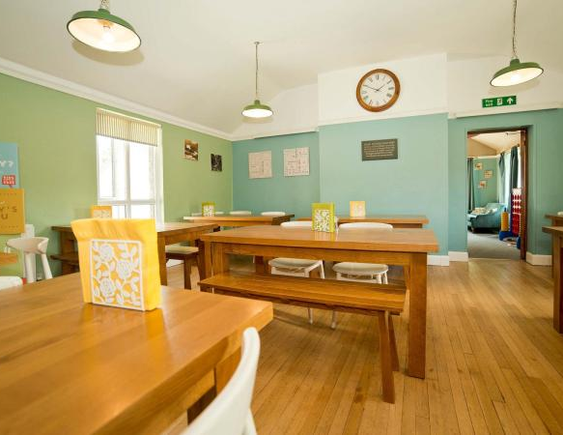
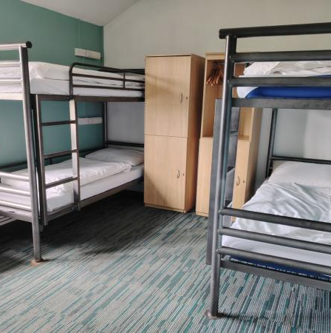
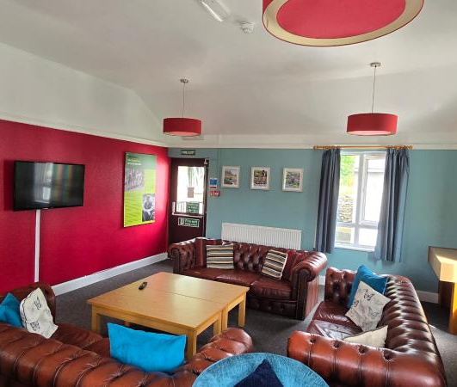
Residential
YHA Malham – Yorkshire Dales
Monday 23rd February to Wednesday 25th February.
Approximate cost £110. This includes the food, accommodation, activities and transport
We have booked all the bedrooms in the main house at the hostel.

Slide 13
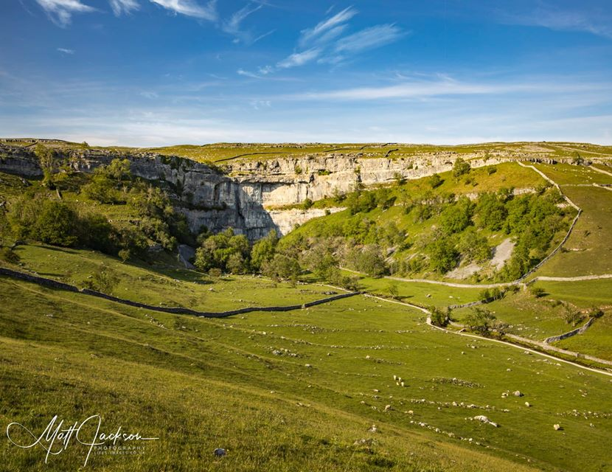
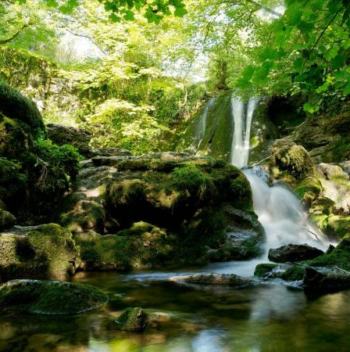
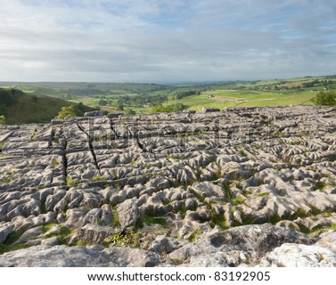
Residential
YHA’s ‘Connecting to Nature’ package.
Fire lighting and campfires
Walks to Malham Cove and Janet’s Foss.

